Slide 1


REAL CLIENT PROJECT

Slide 2



Team Members
Maha Alrooqi
Hibah Sindi
Data Analyst
ML Engineer

Slide 3

History

Slide 4
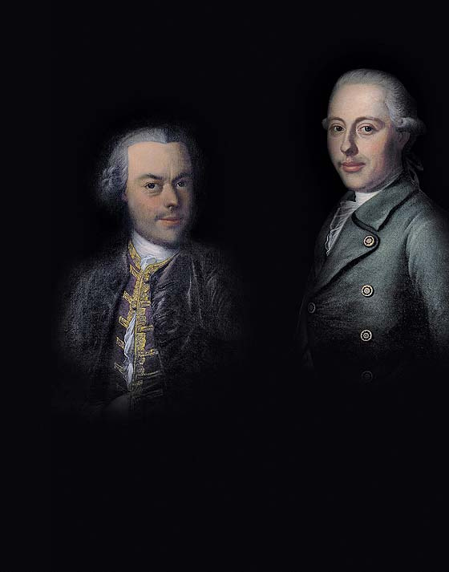
Project Overview
The project focuses on extracting precise data about Jaquet Droz watches from their website to fulfill client requests. Utilizing Python and BeautifulSoup for web scraping, our goal is to provide comprehensive insights into Jaquet Droz's product range, ensuring accuracy and error-free data extraction to meet client expectations

Slide 5
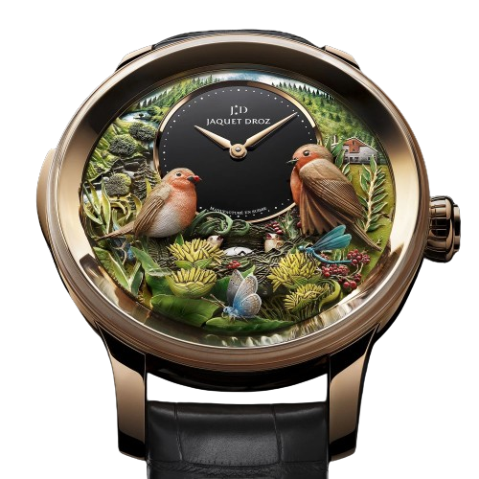

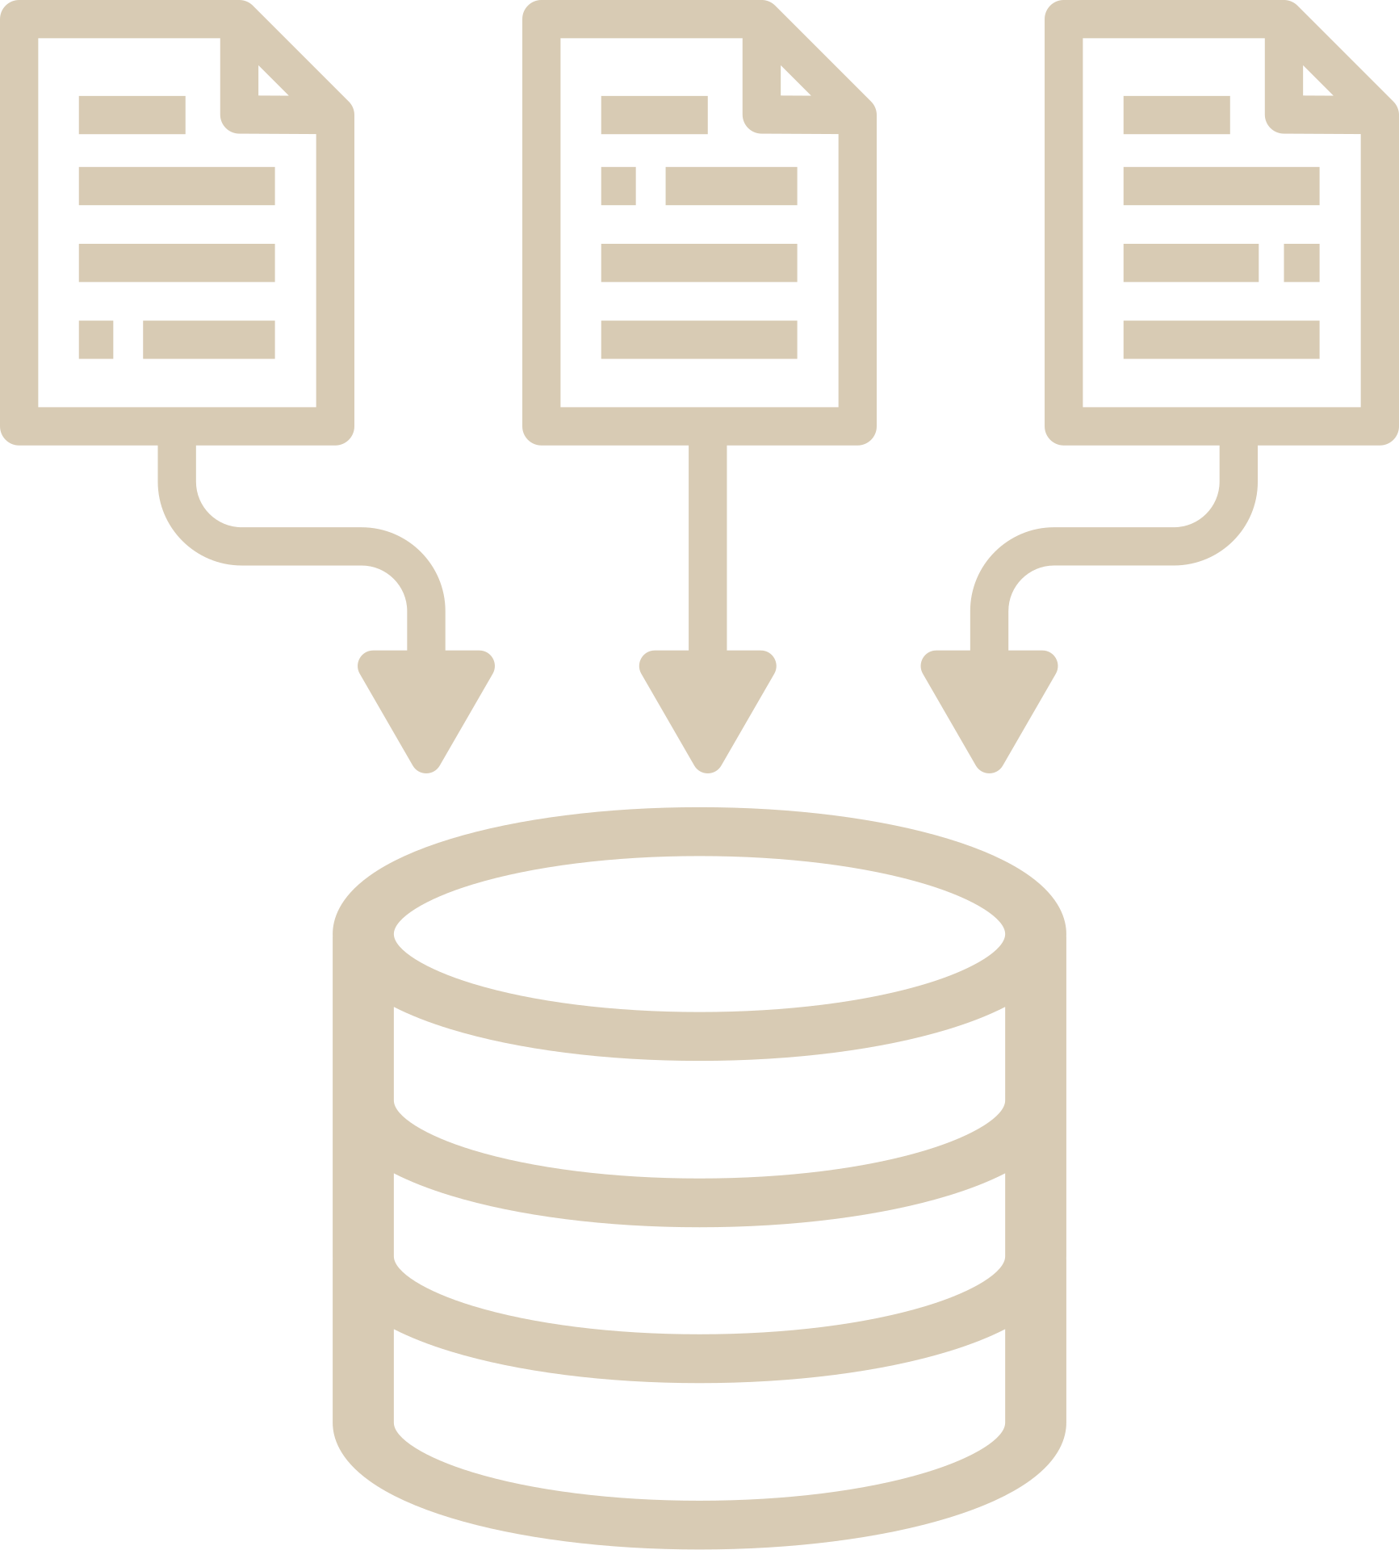

Business Requirements
Data Cleaning
Visualization
Data Collection
Create Report
Data Analysis
Convert to CSV file

Slide 6



Scraping Methodology
DATA COLLECTION
Powerful open-source library
Parse HTML and XML documents
Simplifies web scraping tasks

Slide 7




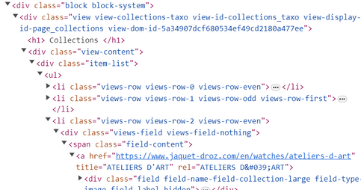
Transforming BR into Executable Code
Finding href
Extracting watch details
from the web page
Getting Whole Text
Storing the details in
a dictionary
Doc.Html
Soup
Preparations
Finding
Class Name
Updating the URL list to
handle different color variants
Finding Tag Names
Extracting data for
all color variants

Slide 8
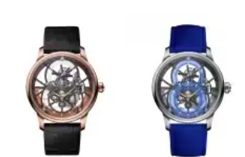
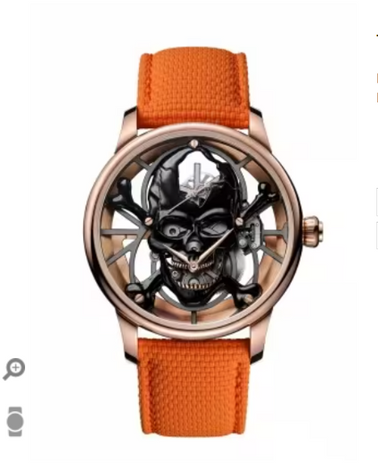

DATA ANALYSIS
Colored Watches
Missing Data
Duplicated Data

Slide 9

DATA CLEANING

Slide 10
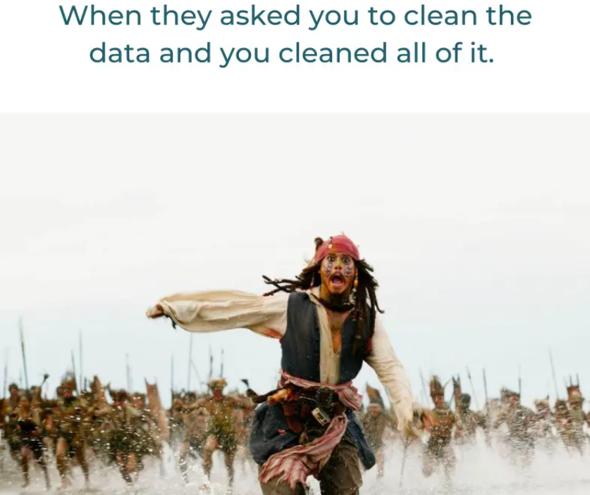
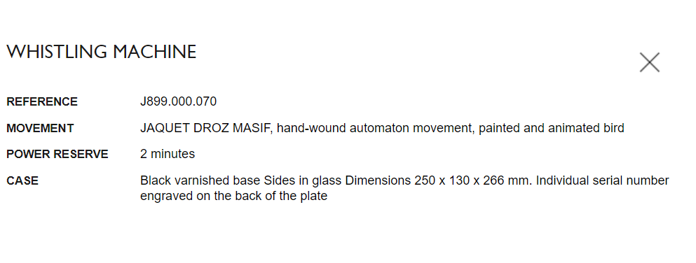
Filling Null with None

Slide 11

CONVERT INTO CSV FILE

Slide 12

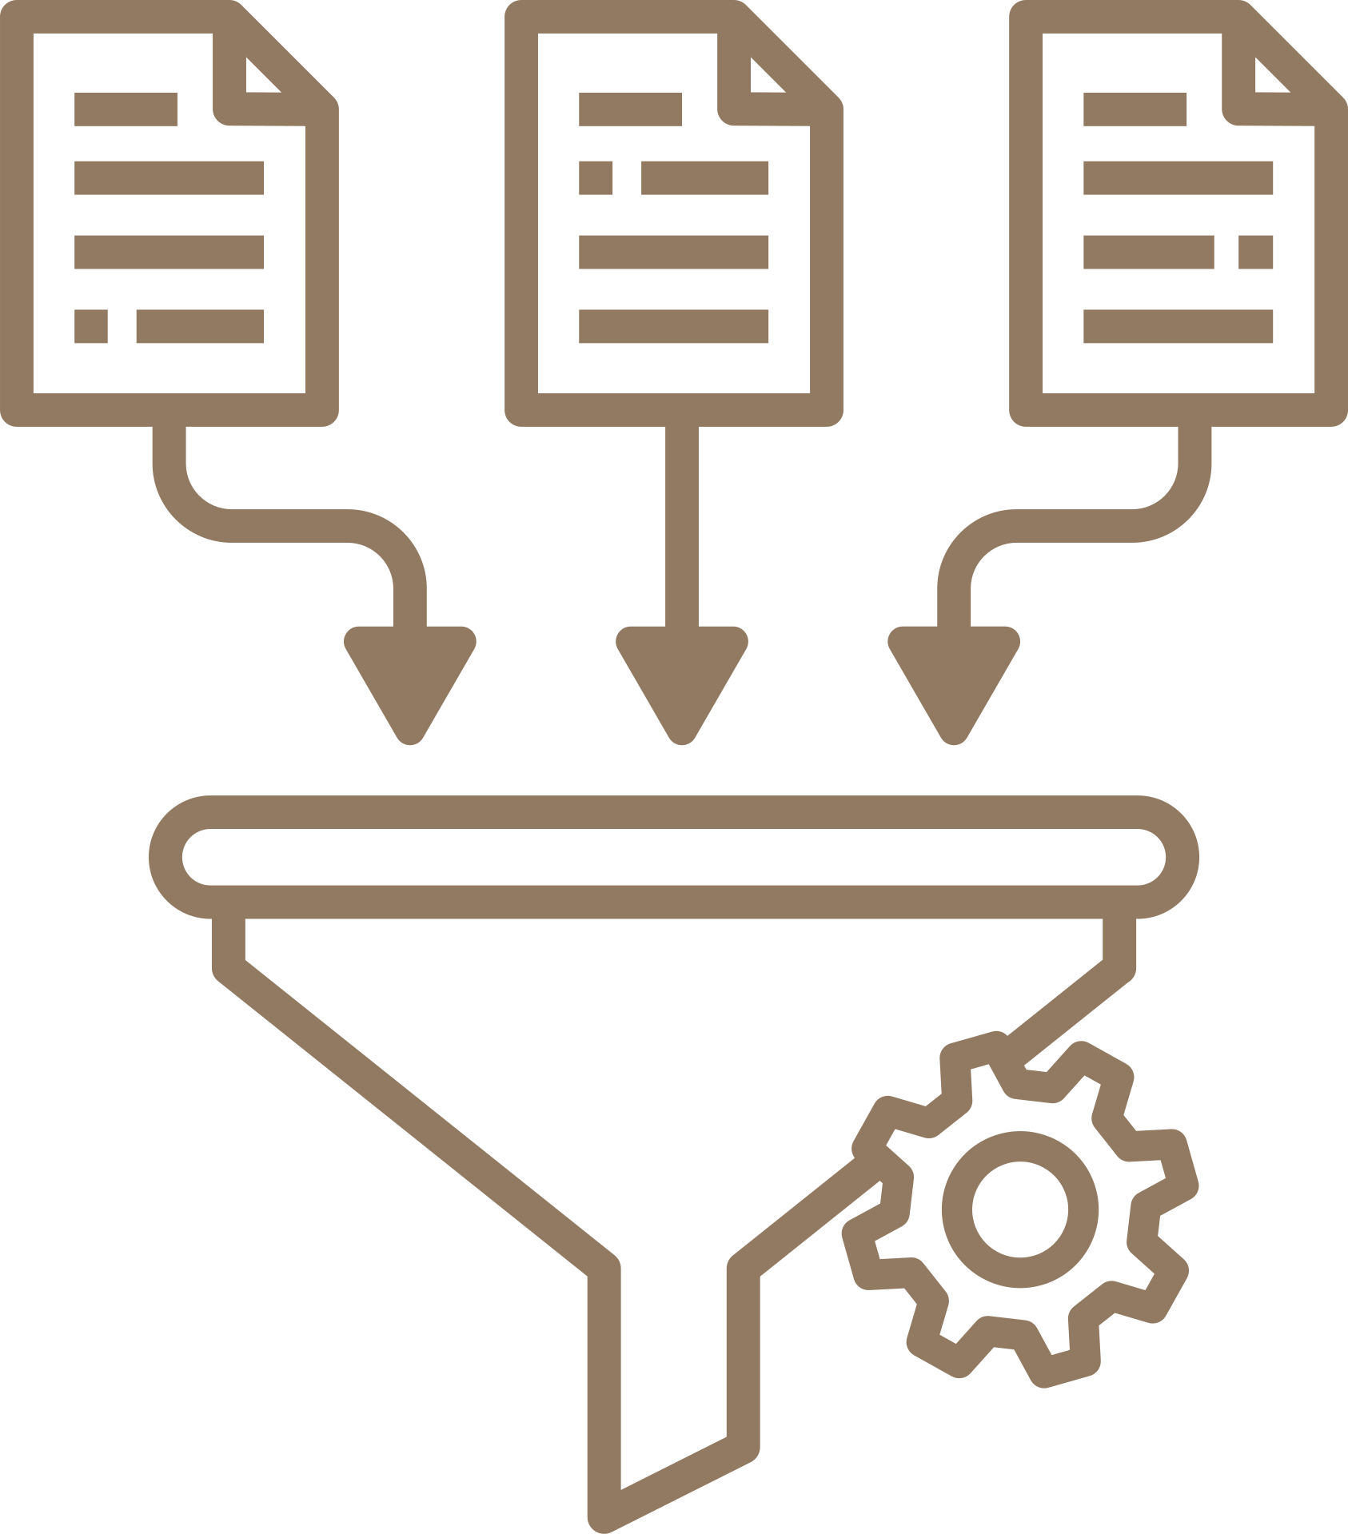
The Results We Have Achieved
Extracted Data
Jaquet Droze Website
67 Unique Watches

Slide 13

DATA VISUALIZATION

Slide 14

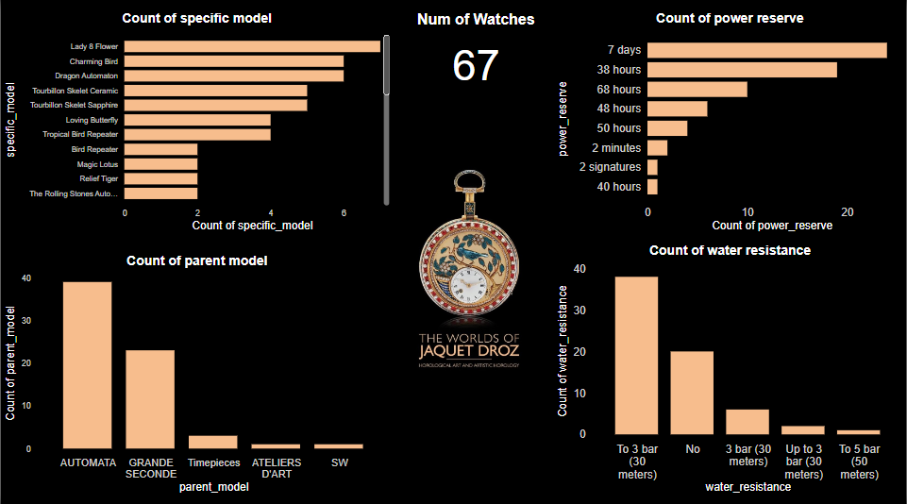
Data Visualizations of the Extracted Data

Slide 15
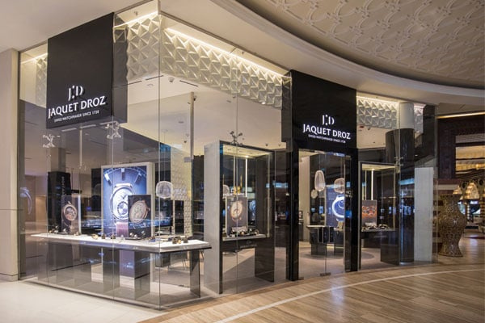
CREATING THE REPORT

Slide 16

valuable insights
Marketing
decision-making
business growth
Product Development
Brand Monitoring

Slide 17

FUTURE PLAN

Slide 18



Slide 19

Thank You

